Slide 1
Making world models use mass correctly
B+: an energy-consistent, mass-affine world model for robot fingers that become heavier than anything seen in training
Chu Lin
Notes:
Today I want to show one idea: if a robot becomes heavier than anything it saw in training, its world model can still predict it well, as long as the mass enters the model in the right place. I will first show the problem, then our model B+, why it extrapolates, how we tested it, and the results.

Slide 2
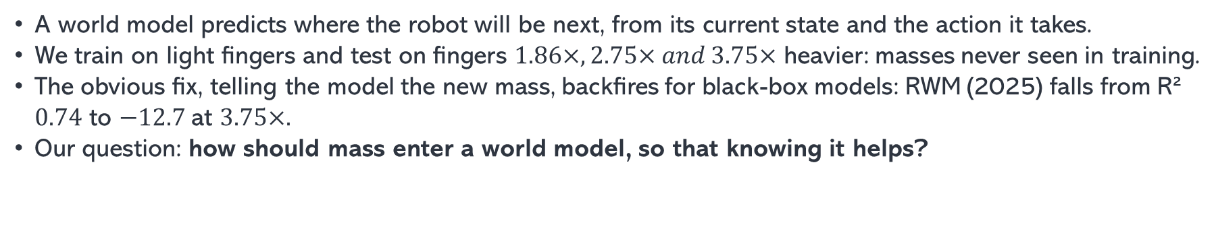
The robot gets heavier than anything in training
A world model predicts where the robot will be next, from its current state and the action it takes.
We train on light fingers and test on fingers $1.86×, 2.75× and 3.75×$ heavier: masses never seen in training.
The obvious fix, telling the model the new mass, backfires for black-box models: RWM (2025) falls from R² $0.74$ to $−12.7$at $3.75×.$
Our question: how should mass enter a world model, so that knowing it helps?
training: 15–27 g per link
test 1.86×
test 2.75×
test 3.75×
CausalWorld space A
CausalWorld space B (held out for generalization)
2
Notes:
A world model is the robot’s internal simulator: given where the fingers are now and the next action, it predicts the next 0.4 seconds. In use, robots get heavier: they pick things up, or parts are replaced. We train only on light fingers, 15 to 27 grams per link, and test on fingers 1.86, 2.75 and 3.75 times heavier. The two heaviest settings are in CausalWorld’s space B, the range the benchmark sets aside for generalization. The natural idea is to tell the model the new mass. For black-box world models this backfires. RWM, a 2025 robotic world model, run with its official code, drops from an R² of 0.74 to minus 12.7 when given the true mass at 3.75 times. R² of 1 is perfect, 0 is no better than predicting the average. So the question is not whether to give the model the mass, but how the mass should enter the model.

Slide 3
B+ puts mass where physics puts it
M(q; m) q̈ = τ + r − f(q, q̇; m)
M is the inertia and f the gravity and Coriolis forces. Both come from one learned energy, E = E₀ + Σₗ mₗ Eₗ: a mass-independent part plus one part per link, multiplied by that link’s mass.
τ is the torque from the robot’s own PD controller, written in exactly as the engineers implemented it.
r is a residual network for contact and friction. It never sees the mass.
Each link’s energy depends only on the joints between it and the base, and the three identical fingers share these modules.
The mass is only ever a multiplier. A network asked about an unseen mass has to guess; a multiplication does not. A variant, B+ (ensemble residual), computes r with an ensemble of five networks.
3
Notes:
B+ is Newton’s law for each finger: inertia times acceleration equals the applied torque, plus the forces the model cannot explain, minus gravity and similar forces. Each term has one job. M and f come from the same learned energy. The energy has a part that does not depend on mass, plus one part per link that is multiplied by that link’s known mass. This matters because a real finger is not strictly proportional: in the simulator about a third of the effective inertia does not change when the links get heavier. Think of a shopping cart: load the basket and it gets harder to push, but the wheels and handle stay the same. Tau is the PD controller the robot actually runs. Engineers wrote it, so we copy it exactly instead of learning it. r is a small network for contact and friction, and it is not allowed to see the mass. Each link’s energy depends only on the joints between that link and the base, which is how a real kinematic chain works. The three fingers are identical, so they share these modules. Compared with our earlier model B, the new parts are the energy-consistent gravity and Coriolis terms, the chain structure and the sharing. The ensemble version only changes r, computing it with five networks instead of one.

Slide 4
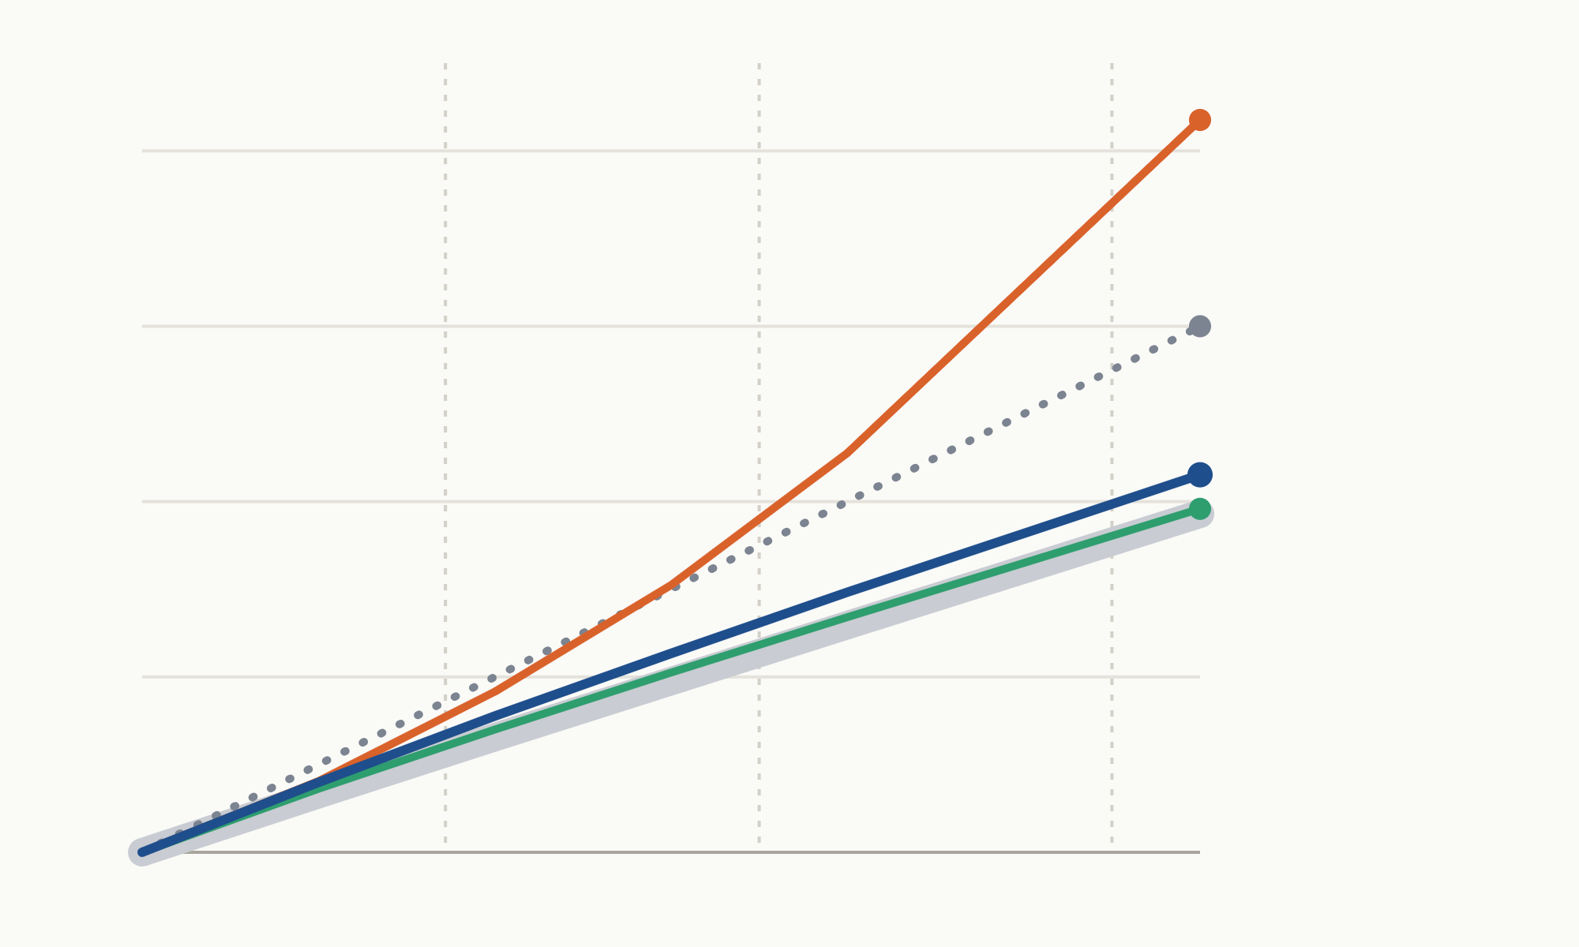
Our models get the inertia right at unseen masses
How much harder to accelerate (×)
The gray band is the simulator, the true answer. Each line is a model’s inertia as the links get heavier.
1.86×
2.75×
3.75×
Mass as input ×5.2
5
Ours follow the truth. At 4× the mass the simulator gives 2.93×; ModLaNet with our affine inertia gives 2.96×, B+ 3.15×.
4
Proportional ×4.0
B+ ×3.15
Older designs drift. Strict proportionality says 4.0×. Feeding mass into a network reaches 5.2×, and the gap grows the further right we go.
3
ModLaNet + affine ×2.96
2
Simulator (truth) ×2.93
1
1
2
3
4
Link mass relative to training (dashed: test levels)
4
Notes:
This slide answers why B+ still works at masses it never saw. How to read it: the horizontal axis is how many times heavier the links are than in training. The vertical axis is how much harder the finger becomes to accelerate with the same torque. A value of 3 means the same push gives one third of the acceleration. The thick gray band is the truth, measured directly in the simulator. At four times the mass, the finger is only 2.93 times harder to push, because about a third of the inertia does not depend on these link masses. The blue line is B+ and the green line is ModLaNet with our affine-inertia component. Both stay on the gray band: 3.15 and 2.96. The dotted line is the old strictly proportional assumption: four times the mass, four times the inertia. That is too heavy, so the predicted finger moves too slowly. The orange line feeds the mass into a neural network, as DeLaN-style models do. It bends upward the further it extrapolates and reaches 5.2. The dashed vertical lines are our three test masses. The further right, the more the lines separate, so the heavier the robot, the larger B+’s advantage should be. The next two slides test exactly that.

Slide 5
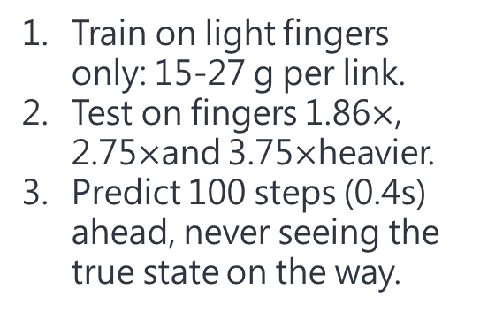
We test against nine baselines at three mass levels
Protocol
Nine baselines
Three questions
Train on light fingers only: 15-27 g per link.
Test on fingers 1.86$×$, 2.75$×$and 3.75$×$heavier.
Predict 100 steps (0.4s) ahead, never seeing the true state on the way.
Black box: RWM (2025, official code) at two training lengths; parameter concatenation (QWM-style).
Is it accurate? R²: 1 is perfect, 0 is no better than the mean.
Does knowing the mass help? R² with the true mass minus R² without.
Physics-structured: DeLaN, ModLaNet, LNN, and our earlier models A and B.
What if it were heavier? Same actions, heavier links: is the predicted change right?
Mass from history: context-aware DeLaN (2025).
5
Notes:
This slide shows how we made the comparison fair. Protocol. During training the model only sees light fingers, 15 to 27 grams per link. At test time we swap in fingers 1.86, 2.75 and 3.75 times heavier, which the model has never seen. The model then predicts 100 steps, 0.4 seconds, on its own, without being corrected by the real state along the way. That is harder than one-step prediction, because errors add up. Nine baselines, in three groups. Black-box world models: RWM from 2025, run with the authors’ official code at two training lengths, and parameter concatenation, which simply appends the mass to the input. Physics-structured models: DeLaN, ModLaNet, LNN, and our own models A and B from the first version of this work. And one model that infers the mass from history: context-aware DeLaN from 2025, which looks at the last 32 steps instead of being told the mass. Three questions. First, is the prediction accurate? We use R²: 1 is perfect, 0 is no better than always predicting the average. Second, does telling the model the true mass help? For the same model, we subtract its score without the mass from its score with the mass; positive means the mass helps. Third, the counterfactual: we replay the same actions with heavier links and check whether the model predicts the right change. Statistics. Each setting has 10 runs: 5 random seeds times two tasks, pushing and picking. The two tasks of one seed share randomness, so we test at the seed level and correct for multiple comparisons with Holm’s method.

Slide 6
The best score at every mass level is ours
Model | Mass | 1.86× | 2.75× | 3.75× | Given mass, 3.75×
RWM (2025, official code) | none | 0.752 | 0.754 | 0.736 | collapses, −13.4
Parameter concat (QWM-style) | none | 0.725 | 0.721 | 0.711 | collapses, −9.4
Context-aware DeLaN (2025) | inferred | 0.718 | 0.724 | 0.702 | n/a
DeLaN | given | 0.754 | 0.731 | 0.678 | +0.05
ModLaNet | given | 0.769 | 0.728 | 0.677 | +0.03
LNN (stabilized) | given | 0.748 | 0.597 | 0.274 | —
v1 model A (learned torque) | none | 0.768 | 0.761 | 0.748 | worse, −0.23
v1 model B (known PD) | given | 0.746 | 0.676 | 0.498 | worse, −0.14
B+ (ours) | given | 0.773 | 0.779 | 0.750 | better, +0.10
ModLaNet + affine (ours) | given | 0.786 | 0.775 | 0.744 | better, +0.10
B+ ensemble residual (ours) | given | 0.801 | 0.784 | 0.753 | better, +0.14
41 of 81
pairwise comparisons significantly better, none significantly worse
35 of 36
tests significantly better than RWM and model A within the first 0.1 s
0.33 → 0.82
counterfactual score of B+ with force abduction, all nine links heavier (1 = exact)
R², median of 10 runs (1 = perfect, 0 = predicting the mean). Models marked “none” are shown without mass, their better setting; the last column is what giving them the true mass does.
6
Notes:
This is the summary table. Each row is a method. The three middle columns are accuracy, R², at the three test masses; closer to 1 is better. The last column says what happens when we give the model the true mass: does it get better or worse? The shaded rows are ours. First, accuracy. The best score at all three mass levels is in the last row, B+ with the ensemble residual: 0.801, 0.784 and 0.753. ModLaNet with our affine-inertia component is significantly better than all nine baselines at 1.86 and 2.75 times. Second, the last column, which is the clearest difference. Black-box models collapse when given the true mass: RWM drops by 13.4. Our earlier models A and B also get worse at the heaviest level. All three of our models get better, by 0.10 to 0.14. On the right, three numbers. 41 of 81: three of our models against nine baselines at three mass levels gives 81 paired comparisons. 41 are significantly better after Holm correction, and none is significantly worse. 35 of 36: in the first 0.1 seconds, steps 10 and 25, our three models are significantly more accurate than the two strongest baselines, RWM and our earlier model A, in 35 of 36 tests. Short-horizon accuracy is what fast robot control relies on most. 0.33 to 0.82: the counterfactual question, what would have happened if all nine links had been heavier. With our force-space abduction, B+ reproduces 82 percent of the true change, up from 33 percent. In one sentence: B+ puts the mass where physics puts it, so the heavier the robot gets, the better it uses that information.

